Slide 1




www.facebook.com/wisdomkalvi
www.wisdomkalvi.com
www.youtube.com/wisdomkalvi

Slide 2
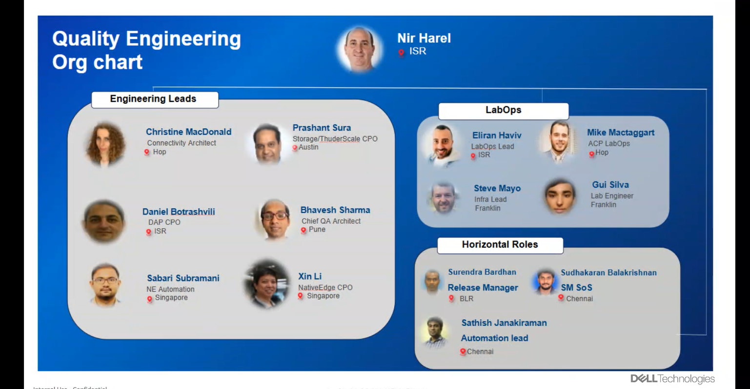

Slide 3
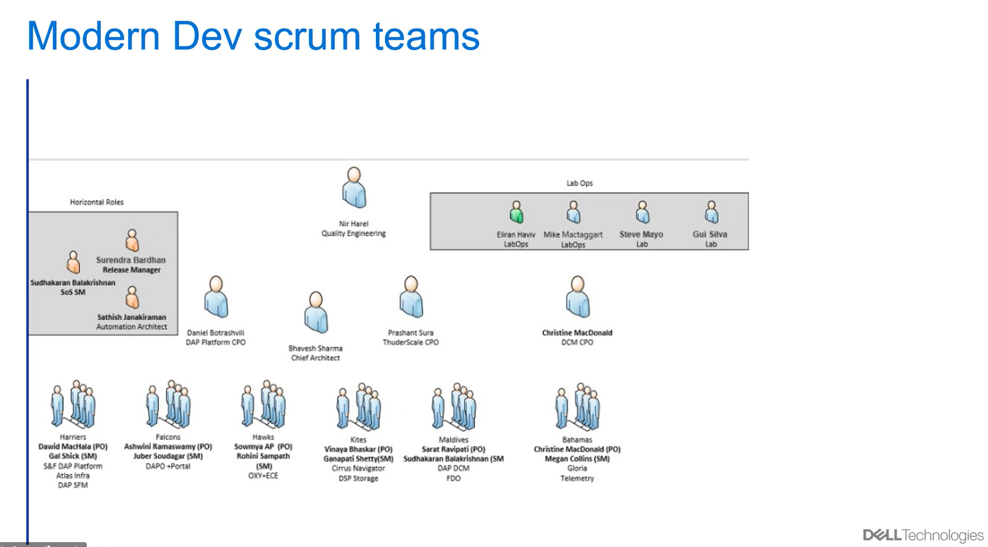

Slide 4
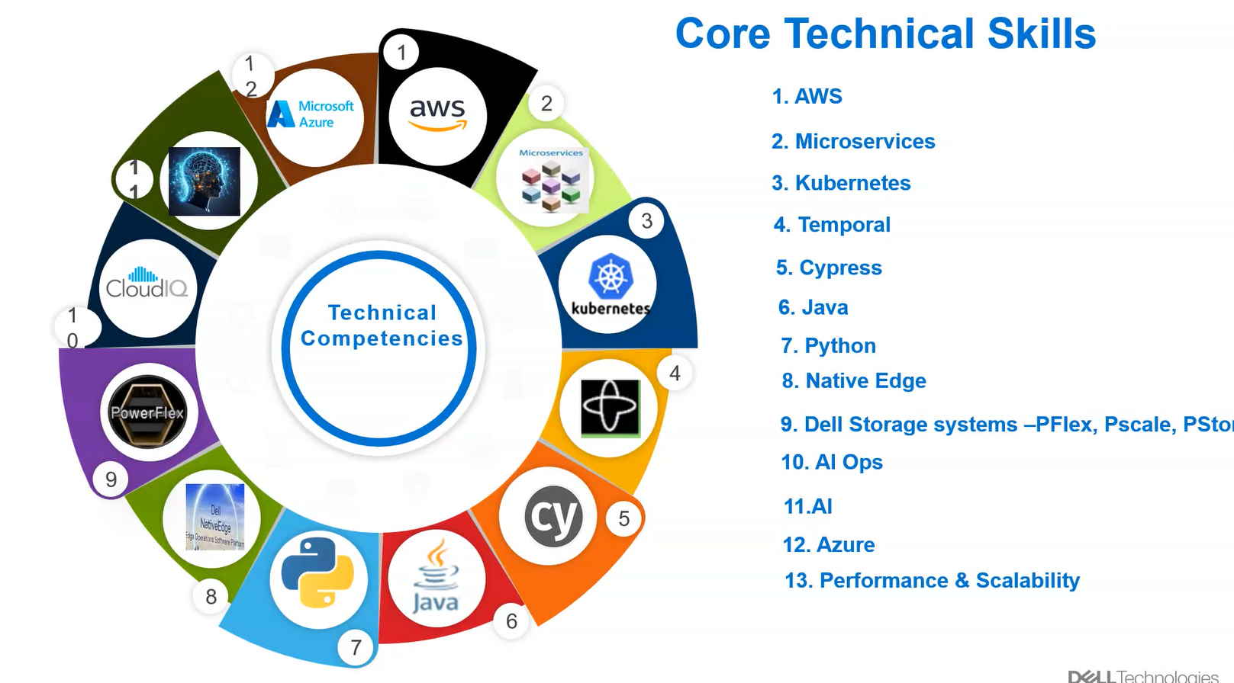

Slide 5
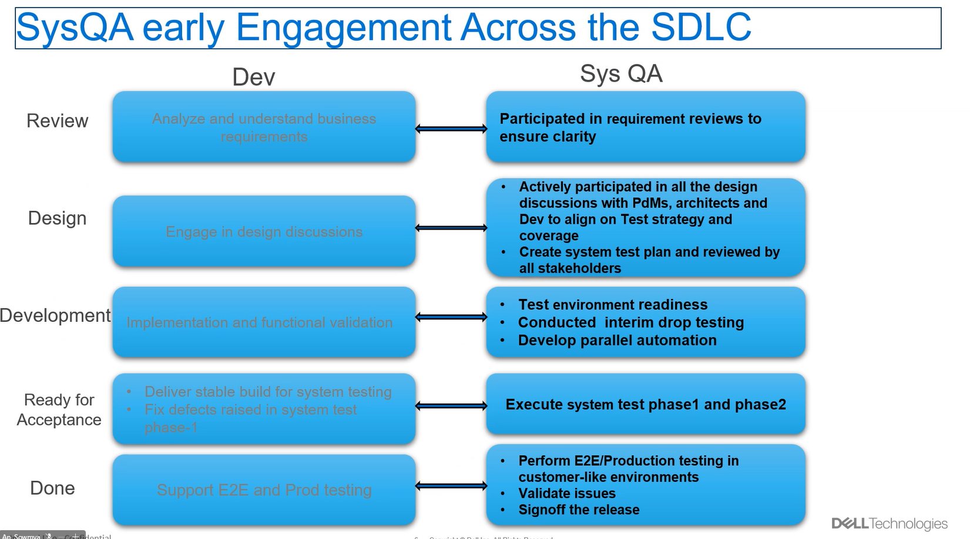

Slide 6
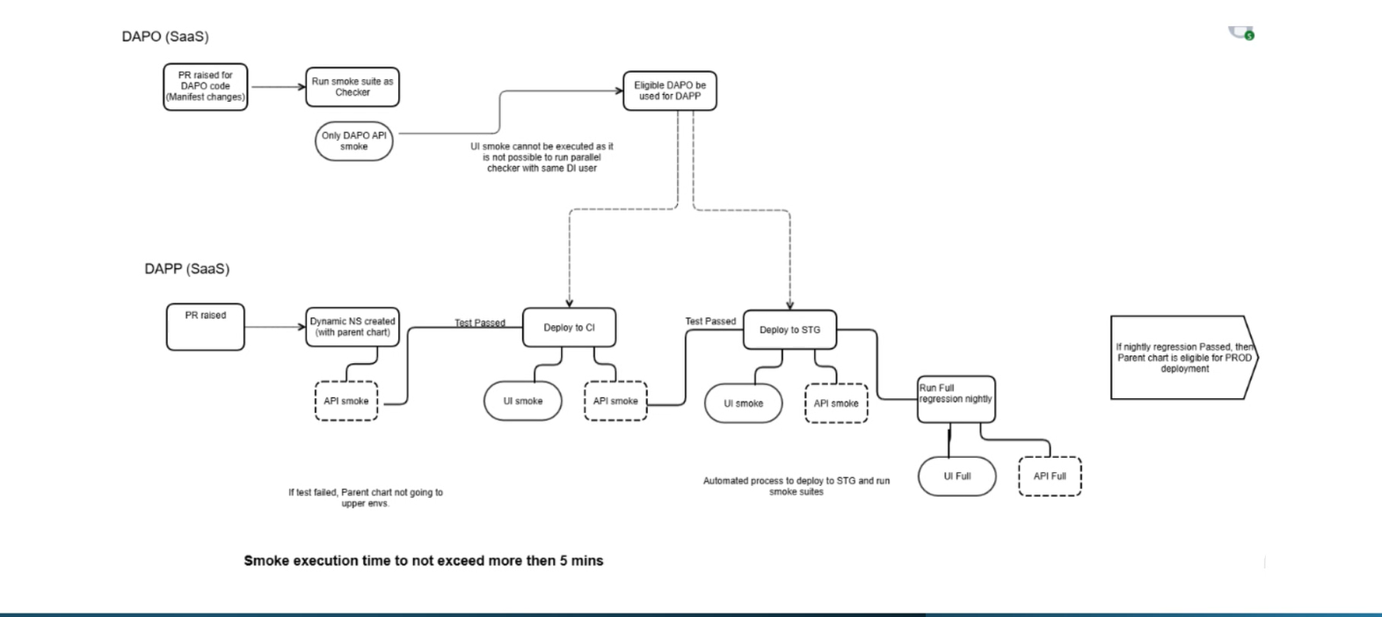

Slide 7
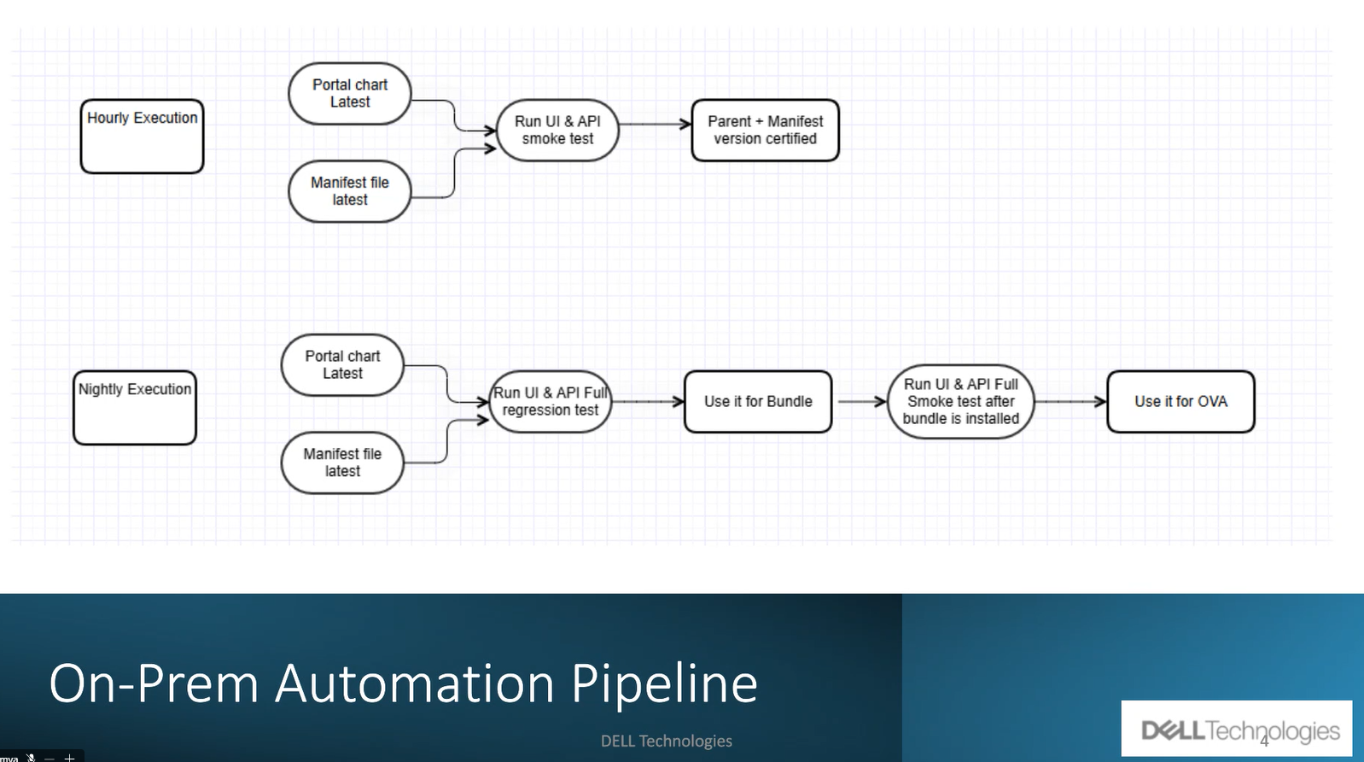

Slide 8
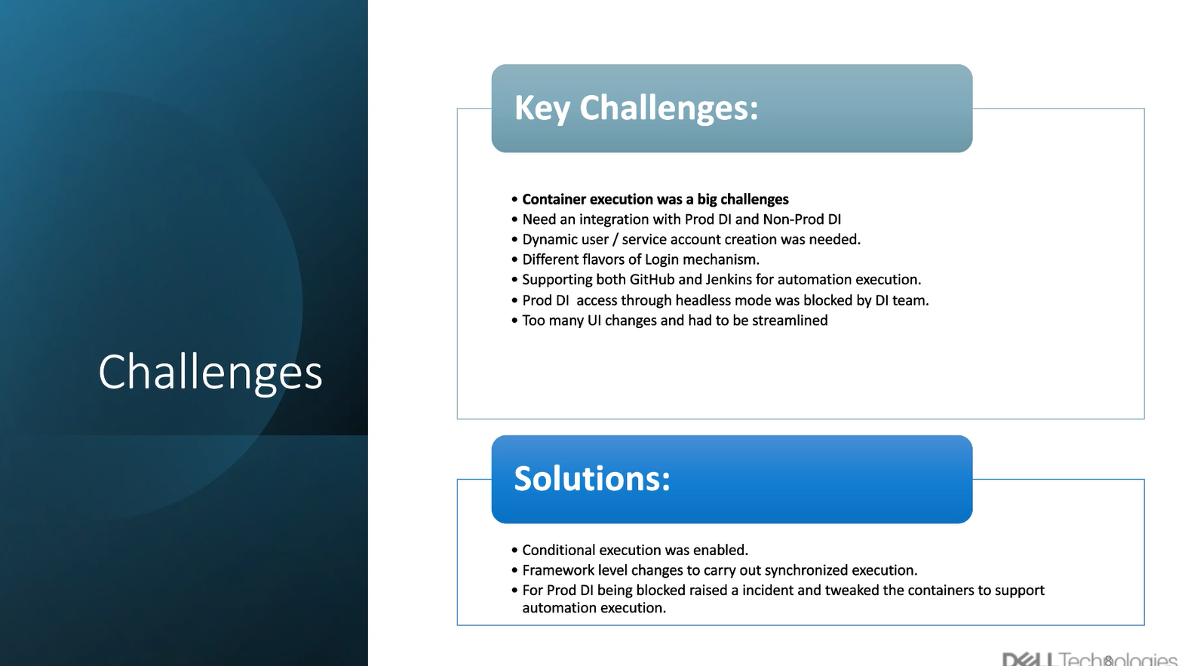

Slide 9
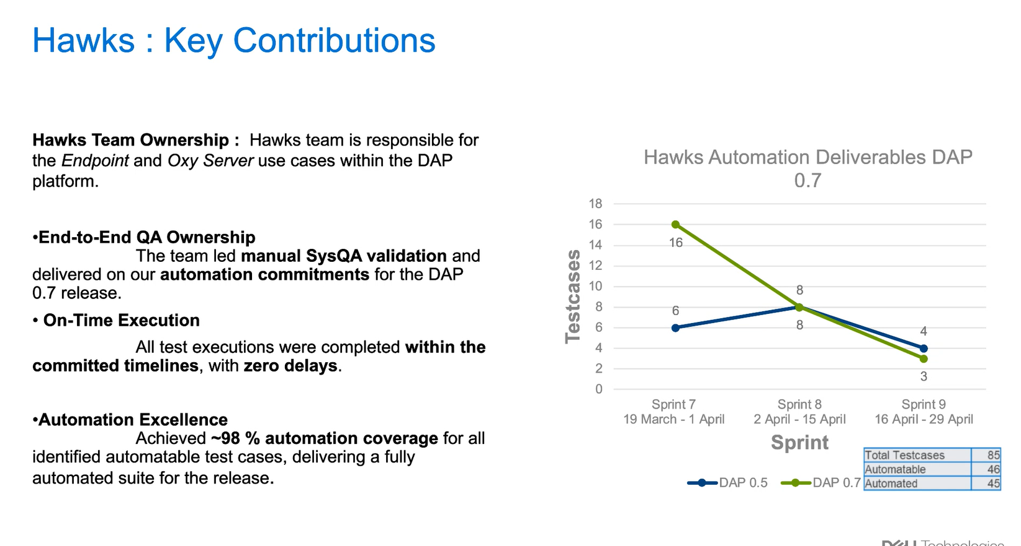

Slide 10
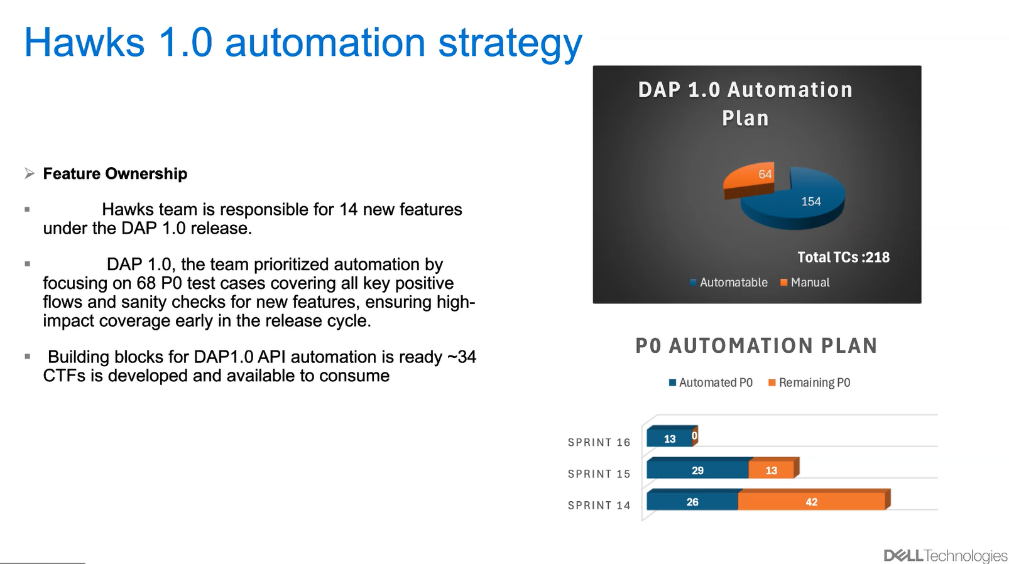

Slide 11


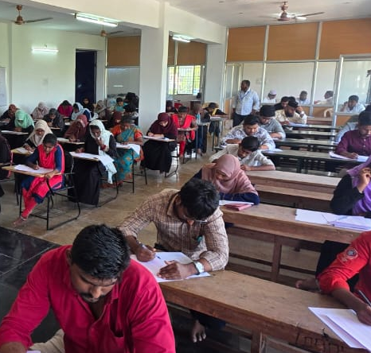
மாநிலம் தழுவிய TNPSC Group 4
மாதிரி தேர்வு (Model Exam) 2025
தேர்வு முடிவுகள் (Exam Result)
வெளியிடும் நிகழ்ச்சி!
மாநில அளவில், மாவட்ட அளவில்
முதல் 3 இடங்களை பிடித்த மாணவ, மாணவிகள் பெயர்கள் அறிவிக்கப்பட உள்ளன
Friday
27 June 2025
3 PM
FEED Office,
No: 10, Makkah Masjid Complex, # 822, Anna Salai,
Chennai - 600002
www.facebook.com/siddique.mtech
என்ற பக்கத்தில் நேரலை (Live) செய்யப்படும்
அரசுப் பணி போட்டித் தேர்வு பயிற்சி மையங்களின் ஒருங்கிணைப்பு குழு

Slide 12



அரசுப் பணி போட்டித் தேர்வு பயிற்சி மையங்களின் ஒருங்கிணைப்பு குழு நடத்திய
மாநிலம் தழுவிய TNPSC Group 4
மாதிரி தேர்வு (Model Exam) 2025
தேர்வு முடிவுகள் (Exam Result)
வெளியிடும் நிகழ்ச்சி!
Friday
27 June 2025
3 PM
FEED Office,
No: 10, Makkah Masjid Complex, # 822, Anna Salai,
Chennai - 600002
www.facebook.com/siddique.mtech
என்ற பக்கத்தில் நேரலை (Live) செய்யப்படும்
அரசுப் பணி போட்டித் தேர்வு பயிற்சி மையங்களின் ஒருங்கிணைப்பு குழு

Slide 13
அரசுப் பணி போட்டித் தேர்வு பயிற்சி மையங்களின் ஒருங்கிணைப்பு குழு நடத்திய
மாநிலம் தழுவிய TNPSC Group 4
மாதிரி தேர்வு (Model Exam) 2025
தேர்வு முடிவுகள் (Exam Result)
வெளியிடும் நிகழ்ச்சி!
Friday
27 June 2025
3 PM
FEED Office,
No: 10, Makkah Masjid Complex, # 822, Anna Salai,
Chennai - 600002
www.facebook.com/siddique.mtech
என்ற பக்கத்தில் நேரலை (Live) செய்யப்படும்
அரசுப் பணி போட்டித் தேர்வு பயிற்சி மையங்களின் ஒருங்கிணைப்பு குழு

Slide 15

Career Guidance Seminar
www.youtube.com/wisdomkalvi
www.wisdomkalvi.com
www.facebook.com/wisdomkalvi

Slide 16
Useful education! Useless Education! பயனுள்ள கல்வி! பயன் இல்லாத கல்வி!
www.facebook.com/wisdomkalvi
www.wisdomkalvi.com
www.youtube.com/wisdomkalvi

Slide 17
Skills
Skills
Knowledge
Degree

Slide 18

UG - > PG -> Phd
தயார் மன நிலையில் இருக்க வேண்டும்
எல்லாமே mindset தான்
www.wisdomkalvi.com
www.youtube.com/wisdomkalvi
www.facebook.com/wisdomkalvi

Slide 19

What to choose ?
www.facebook.com/wisdomkalvi
www.wisdomkalvi.com
www.youtube.com/wisdomkalvi

Slide 20

Focus on specific goals
Not on specific courses

Slide 21
Tech Professional
Researcher
Teaching
Medical Professional
Govt. Officers
IAS / IPS, Gr.I etc…
Law / Judiciary
Journalism
Multimedia
Accounting
CA / CS / CMA etc…
Executives
Innovative Entrepreneur
www.facebook.com/wisdomkalvi
www.wisdomkalvi.com
www.youtube.com/wisdomkalvi

Slide 22
பத்தாம் வகுப்பு (10th) முடித்த பிறகு
என்ன படிக்கலாம்?

Slide 23

Mathematics, Physics, Chemistry, Biology
கணிதம், இயற்பியல், வேதியியல், உயிரியல்
Mathematics, Physics, Chemistry, Computer Science
கணிதம், இயற்பியல், வேதியியல், கணிணி அறிவியல்
Physics, Chemistry, Botany, Zoology
இயற்பியல், வேதியியல், தாவரவியல், விலங்கியல்

Slide 24
Commerce / Accountancy / Economics / Statistics
வணிகவியல், கணக்குப் பதிவியல், பொருளியல், புள்ளியியல்
History / Economics / Commerce / Accountancy
வரலாறு, பொருளியல், வணிகவியல், கணக்குப் பதிவியல்
Business Mathematics / Computer Applications
வணிகக் கணிதம் / கணினி பயன்பாடுகள்

Slide 25
12th முடித்த பிறகு
என்ன படிக்கலாம்?

Slide 26

Tech Professional

Slide 27

தொழில் நுட்ப துறை (Tech Industry)
Software
Automation
Data Analytics
Machine learning, AI
Media, Graphics
Robotics
B.E (CSE)
B.Tech (IT)
B.E (ECE)
B.Sc (CS)
B.Sc (IT)
B.C.A
B.Sc (Maths)
B.Sc (Stat.)
www.youtube.com/wisdomkalvi

Slide 28
B.E CSE
Computer Science and Engineering
B.Tech IT
Information technology
B.E ECE
Electronics & Communication Engineering

Slide 29

COMPUTER SCIENCE AND ENGINEERING (AI AND MACHINE LEARNING)
COMPUTER SCIENCE AND ENGINEERING (DATA SCIENCE)
COMPUTER SCIENCE AND ENGINEERING (BIG DATA ANALYTICS)
COMPUTER SCIENCE AND ENGINEERING (INTERNET OF THINGS)
COMPUTER SCIENCE AND ENGINEERING (CYBER SECURITY)
COMPUTER SCIENCE AND ENGINEERING (IoT & CYBER SECURITY INCLUDING BLOCK CHAIN TECHNOLOGY)
COMPUTER SCIENCE AND DESIGN
ARTIFICIAL INTELLIGENCE AND DATA SCIENCE
ARTIFICIAL INTELLIGENCE AND MACHINE LEARNING
CYBER SECURITY

Slide 30
Civil
EEE

Slide 31
AERONAUTICAL ENGINEERING
MARINE ENGINEERING
ROBOTICS AND AUTOMATION
BIO MEDICAL ENGINEERING
GEO INFORMATICS
FOOD TECHNOLOGY
CHEMICAL ENGINEERING
PETROLEUM ENGINEERING
AUTOMOBILE ENGINEERING
MANUFACTURING ENGINEERING
PRODUCTION ENGINEERING
TEXTILE TECHNOLOGY

Slide 32
Medical Professional
Courses
Exam
College
MBBS / BDS
Siddha (B.S.M.S)
Ayurveda (B.A.M.S)
Unani (B.U.M.S)
NEET
Govt. Medical colleges
www.facebook.com/wisdomkalvi
www.wisdomkalvi.com
www.youtube.com/wisdomkalvi

Slide 33
Without NEET
Paramedical
B.P.T. (Physiotherapy)
Paramedical
B.Sc Radiography & Imaging Technology
B.Sc Dialysis Technology
B.O.T. (Occupational Therapy)
B.Sc Radiotherapy Technology
B.ASLP (Audiology and Speech Language Pathology)
B.Sc (Nursing)
B. Pharm
B.Sc. Medical Laboratory Technology
➢ B.Sc. CLINICAL NUTRITION
➢ B.Sc. CRITICAL CARE TECHNOLOGY
➢ B.Sc. NEURO ELECTRO PHYSIOLOGY
➢ B.OPTOM
Veterinary
BVSc & AH
www.youtube.com/wisdomkalvi
www.facebook.com/wisdomkalvi
www.wisdomkalvi.com
www.youtube.com/wisdomkalvi

Slide 34
Paramedical Diploma – 2 years
Dip. Nursing
Paramedical Certificate – 1 year
Anaesthesia Technician
DMLT
D.Pharm
Dental Mechanic
Dip. Medical Record Science
Medical Record Technician
Dip. Optometry
Theatre Technician
Orthopaedic Technician
ECG/Treadmill Technician
Emergency Care Technician
Respiratory Therapy Technician
Dialysis Technician
Cardiac Sonography Technician
Without NEET
www.facebook.com/wisdomkalvi
www.wisdomkalvi.com
www.youtube.com/wisdomkalvi
www.youtube.com/wisdomkalvi

Slide 35
B.Sc (Botany) B.Sc (Zoology) B.Sc (Bio-Chem) B.Sc (Micro-Bio)
M. Sc. Neuroscience
M. Sc. Medical Microbiology
M. Sc. Biomedical Genetics
M. Sc. Medical Biochemistry
M. Sc. Biotechnology
M. Sc. Biochemistry
www.facebook.com/wisdomkalvi
www.wisdomkalvi.com
www.youtube.com/wisdomkalvi

Slide 36

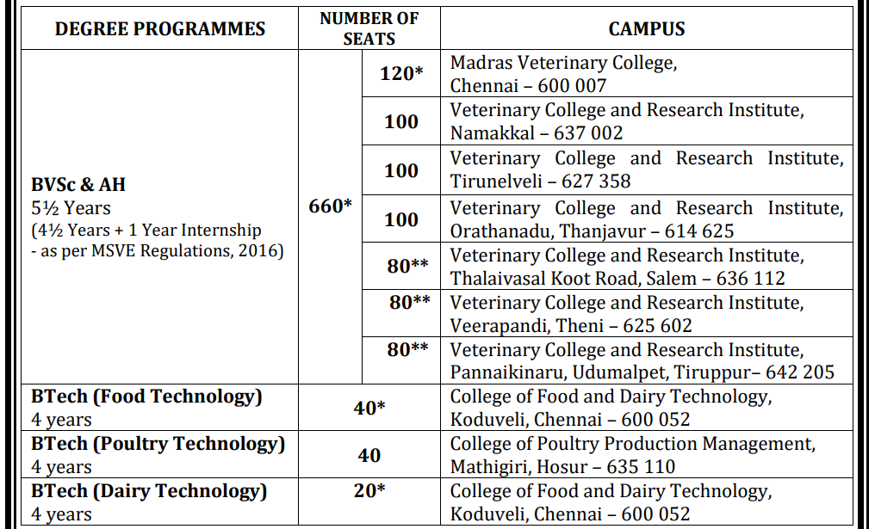

Slide 37

Courses
➢ B.F.Sc. (Bachelor of Fisheries Science) ➢
B.Tech. (Fisheries Engineering)
B.Tech. (Energy & Environmental Engineering)
➢ B.Tech. (Biotechnology)
➢ B.Tech. (Food Technology)
➢ B.B.A. (Fisheries Enterprises Management)
➢ B.Voc. (Industrial Fish Processing Technology)
➢ B.Voc.(Industrial Aquaculture)
➢ B.Voc.(Industrial Fishing Technology)
450 - seats
Colleges
Fisheries College and Research Institute, Thoothukudi
Dr. M.G.R. Fisheries College and Research Institute, Ponneri
Dr. M.G.R Fisheries College and Research Institute, Thalainayeru, Nagapattinam
College of Fisheries Engineering, Nagapattinam
Institute of Fisheries Post Graduate Studies, Vaniyanchavadi, OMR, Chennai
Institute of Fisheries Biotechnology, Vaniyanchavadi, OMR, Chennai
TNJFU - Business School (Fisheries), Vaniyanchavadi, OMR, Chennai
College of Fish Nutrition and Food Technology, Madhavaram, Chennai
College of Fisheries Nautical Technology, Thoothukudi
College of Energy & Environmental Engineering, Nagapattinam
Fisheries College & Research Institute, Mayiladi, Kanyakumari

Slide 38

Courses
B. Sc. (Hons.) Agriculture
B. Sc. (Hons.) Horticulture
B. Sc. (Hons.) Forestry
B. Sc. (Hons.) Sericulture
B. Sc. (Hons.) Food, Nutrition and Dietetics
B. Tech. (Agricultural Engineering)
B. Tech. (Food Technology)
B. Tech. (Biotechnology)
B. Tech. (Energy and Environmental Engineering)
B. S. (Agribusiness Management)
B.Tech. (Agricultural Information Technology) B.Tech. (Bioinformatics) &
Colleges (18 Govt colleges 3423 seats)
AGRICULTURAL COLLEGE AND RESEARCH INSTITUTE, COIMBATORE
HORTICULTURAL COLLEGE AND RESEARCH INSTITUTE, COIMBATORE
AGRICULTURAL ENGINEERING COLLEGE AND RESEARCH INSTITUTE, COIMBATORE
SCHOOL OF POSTGRADUATE STUDIES, COIMBATORE
AGRICULTURAL COLLEGE AND RESEARCH INSTITUTE, MADURAI
COMMUNITY SCIENCE COLLEGE AND RESEARCH INSTITUTE, MADURAI
AGRICULTURAL ENGINEERING COLLEGE AND RESEARCH INSTITUTE, KUMULUR
ANBIL DHARMALINGAM AGRICULTURAL COLLEGE AND RESEARCH INSTITUTE, TRICHY
HORTICULTURAL COLLEGE AND RESEARCH INSTITUTE FOR WOMEN, TRICHY
AGRICULTURAL COLLEGE AND RESEARCH INSTITUTE, KILLIKULAM
HORTICULTURE COLLEGE AND RESEARCH INSTITUTE, PERIYAKULAM, THENI
FOREST COLLEGE AND RESEARCH INSTITUTE, METTUPALAYAM
AGRICULTURAL COLLEGE AND RESEARCH INSTITUTE, EACHANGKOTTAI, THANJAVUR
AGRICULTURAL COLLEGE AND RESEARCH INSTITUTE, KUDUMIYANMALAI, PUDUKKOTTAI
AGRICULTURAL COLLEGE AND RESEARCH INSTITUTE, VAZHAVACHANUR, TIRUVANNAMALAI

Slide 39
Commerce, Accountancy History Branch
CUET
B.A / B.Com
CLAT Exam Law (LLB)
B.Com with
e-commerce
B.Com with
Taxation
B.A (English)
CA, CS, CMA Exam
Govt Jobs
MBA with CAT/ TANCET Exam
www.facebook.com/wisdomkalvi
www.wisdomkalvi.com
www.youtube.com/wisdomkalvi

Slide 40
B.A (Economics) B.A (History)
M.A. Econometrics
M.A. Financial Economics
M.A. Journalism & Mass Communication
M.A. Ancient History and Archaeology
Post-Graduate Diploma in Archaeology - Institute of Archaeology
M.A. Anthropology
M.A. Defense and Strategic Studies
M.A. International Relations
M.Sc. Criminology and Criminal Justice Science
www.facebook.com/wisdomkalvi
www.wisdomkalvi.com
www.youtube.com/wisdomkalvi

Slide 41

Management Studies
Hotel management
Airline / Airport management
Logistics
Digital marketing
Human Resource
www.facebook.com/wisdomkalvi
www.wisdomkalvi.com
www.youtube.com/wisdomkalvi

Slide 42
Researcher
Skills
Courses
College
Reading
Self Starter
Searching
Solution provider
English
Communication
B.Sc (Maths, Phy, Chem) etc..
B.A (Economics, history) etc..
M.Sc, M.A
PhD
State Universities
Central Universities
Foreign Universities
www.facebook.com/wisdomkalvi
www.wisdomkalvi.com
www.youtube.com/wisdomkalvi

Slide 43
B.Sc (Physics) B.Sc (Chemistry) B.Sc (Mathematics)
M.Sc - AU, IIT (JAM)
M.Sc in Madras University
M.Sc. Criminology and Criminal Justice Science
M.Sc. Cyber Forensics & Information Security
M.Sc. Statistics
M.Sc .Actuarial Science
M.Sc. Polymer Chemistry
M.Sc. Analytical Chemistry
M.Sc. Medical Biochemistry
M.Sc. Energy and Materials Science
M.Sc. Biophysics
M.Sc. Neuroscience
M.Sc. Bio- Photonics
M.Sc. Nanoscience & Nanotechnology
M.Sc. Applied Geography
www.youtube.com/wisdomkalvi

Slide 44
After M.Sc
GATE/CEETA
M.E/M.Tech - AU, IIT
PhD
Research opportunities
www.youtube.com/wisdomkalvi

Slide 45
Research Exams
CSIR-NET: This is a national-level exam for Junior Research Fellowships (JRFs) and Lectureships in various science disciplines, administered by the Council of Scientific and Industrial Research (CSIR).
UGC-NET: The University Grants Commission's (UGC) NET exam is another national-level exam for JRFs and Lectureships, covering a wide range of subjects
GATE: The Graduate Aptitude Test in Engineering (GATE) is primarily for engineering and technology but also includes some science subjects, offering opportunities for research in these fields.
JEST: The Joint Entrance Screening Test for Physics and Theoretical Computer Science is a national-level exam recognized by the Science & Engineering Research Board (SERB).
University-Specific Exams: Many Indian universities conduct their own entrance exams for Ph.D. programs, like the JNU PhD entrance exam and the BITS PhD entrance exam.
ICAR-JRF, DBT JRF : The Indian Council of Agricultural Research (ICAR) conducts the Joint Research Fellowship (JRF) exam for those interested in agricultural research. The Department of Biotechnology (DBT) also conducts a JRF exam for students interested in biotechnology research

Slide 46
Professors
Skills
Courses
College
Reading
Teaching
Presentation skill
English
Good Communication
B.Sc (Maths, Phy, Chem) etc..
B.A (Economics, history) etc..
M.Sc, M.A
PhD
NET / TNSET
State Universities
Central Universities
Foreign Universities
www.facebook.com/wisdomkalvi
www.wisdomkalvi.com
www.youtube.com/wisdomkalvi

Slide 47

Teaching
B.A (English)
B.Sc (Mathematics)
B.Sc (Physics)
B.Sc (CS)
For College Graduates
For School students
English, Mathematics
Scientific experiments
Problem solving skill
Entrance exam trainings
Tech trainings
Project based trainings
Soft skill trainings
www.facebook.com/wisdomkalvi
www.wisdomkalvi.com
www.youtube.com/wisdomkalvi

Slide 48
Govt Sector
Skills
Courses
College
Self Motivation
Diligence
Dedication
Activeness
English
Problem solving skills
Any Degree
Any Universities
www.youtube.com/wisdomkalvi

Slide 49
List of Govt. Jobs Exams
TNPSC
TNUSRB
TNFUSRC
TNEB
UPSC
SSC
AAI
RRB
www.facebook.com/wisdomkalvi

Slide 50

Government Jobs
B.A (Political Science)
B.A (Economics)
B.Sc (Mathematics)
B.A (Tamil)
B.A (History)
B.A (English)
www.facebook.com/wisdomkalvi
www.wisdomkalvi.com
www.youtube.com/wisdomkalvi

Slide 51
Law / Judiciary
Skills
College
English
Presentation Skill
Good Communication
Deep Reading
LLB (after +2 or degree)
CLAT exam (NLU)
Civil Judge Exams
National Law University
SOCL - School of excellence in law
www.facebook.com/wisdomkalvi
www.wisdomkalvi.com
www.youtube.com/wisdomkalvi

Slide 52
Multi-Media
Skills
Courses
Creativity
Presentation skill
Programing knowledge
BFA (Visual Communication Design)
Digital Marketing
B.Sc in Animation and Multimedia
Any Degree with Multimedia / Animation certificates
College
Any College
Univ. Colleges
www.facebook.com/wisdomkalvi
www.wisdomkalvi.com
www.youtube.com/wisdomkalvi

Slide 53
பெண்களுக்கு ஏற்ற சிறந்த படிப்புகள்
Teaching
Medical
Government Job
IT
Research

Slide 54
Summary

Slide 55
Three Way
Entrance Exam
High Mark
UG
Normal Colleges
PG Entrance Exam
Premium Colleges
PG
Skills
PhD
Good career
www.facebook.com/wisdomkalvi
www.wisdomkalvi.com
www.youtube.com/wisdomkalvi

Slide 56
Entrance Exam (UG)
1. மருத்துவம் (Medicine)
NEET நுழைவு தேர்வு
2. பொறியியல் (Engineering)
JEE நுழைவு தேர்வு
3. சட்டம் (Law)
CLAT நுழைவு தேர்வு
4. கலை, அறிவியல் (Arts & Science) CUET நுழைவு தேர்வு
www.facebook.com/wisdomkalvi
www.wisdomkalvi.com
www.youtube.com/wisdomkalvi

Slide 57
Entrance Exams (PG)
M.Sc
MBA
MCA
IIT – JAM
AU – AU Entrance
MU – Univ. Entrance
CAT
TANCET
CUET
Univ. Entrance
NIMCET
TANCET
Univ. Entrance
M.E / M.Tech
GATE
CEETA
M.A
LAW
Univ. Entrance
CLAT
www.facebook.com/wisdomkalvi
www.wisdomkalvi.com
www.youtube.com/wisdomkalvi

Slide 58



Insult
Frustration
Rejection
Failures
Mistakes

Slide 59

Wisdom - கல்வி, வேலை வாய்ப்பு வழிகாட்டி
www.youtube.com/wisdomKalvi
www.facebook.com/wisdomkalvi
www.wisdomkalvi.com

Slide 60
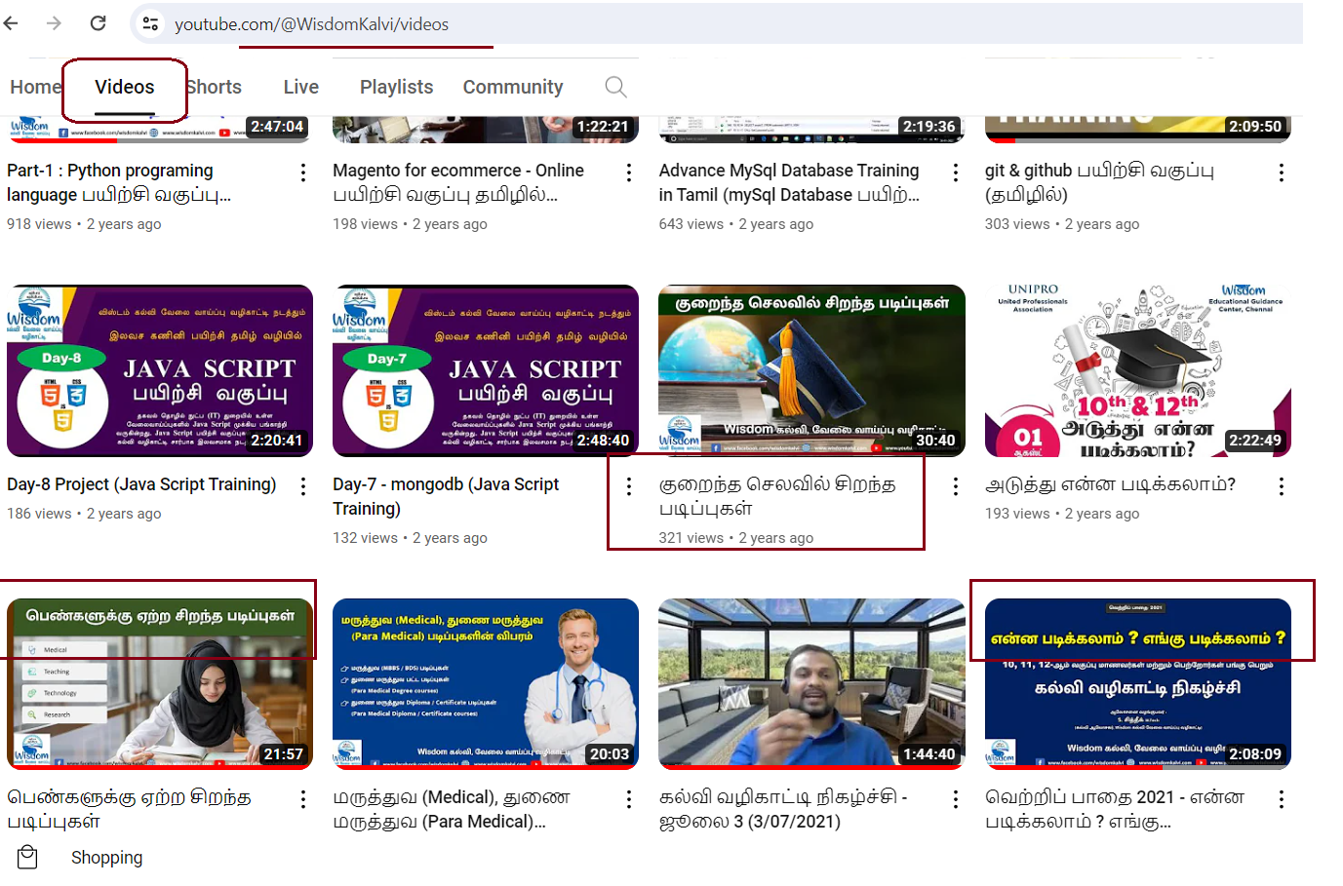

Slide 61

Q & A

